Slide 1
Precision Loan Eligibility System

Slide 2


1
Bandi, Mallikarjuna Reddy
TEAM MEMBERS
2
Yarlagadda, Nikitha
3
Labba, Yeswanth

Slide 3
Project Overview:
It aims to enhance financial institutions' loan decision processes by building an accurate and explainable loan eligibility model.
Objective:
Develop a model that reliably predicts loan eligibility by addressing data quality, enhancing interpretability, and reducing potential biases in predictions.
Significance:
Accurate predictions minimize risk, optimize approval rates, and ensure compliance with financial regulations.

Slide 4
Why this application?
Our "Loan Eligibility Prediction" application delivers an all-inclusive solution by using predictive analytics, process automation, and refined risk management.
Machine Learning Techniques: We apply advanced algorithms to evaluate borrower risk with high accuracy, reducing approvals for high-risk loans.
Streamlined Approval Process: we drastically shorten loan approval timelines, ensuring faster and more efficient credit access.
Enhanced Risk Assessment: With real-time data updates and detailed borrower profiles, our solution provides more accurate risk analysis, lowering default rates and access more affordable loan options.

Slide 5
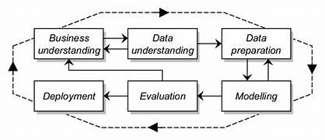
Methodology Used: CRISP-DM

Slide 6
Business Understanding
Industry: Finance, specifically loan approvals and risk assessment
Challenge: Traditional loan models are often inaccurate due to poor data quality, missing values, and simplistic decision rules. These issues can lead to false approvals or rejections, impacting both lenders and applicants.
Impact: Predictify addresses these challenges by improving prediction accuracy, which in turn can reduce defaults and boost customer satisfaction.

Slide 7
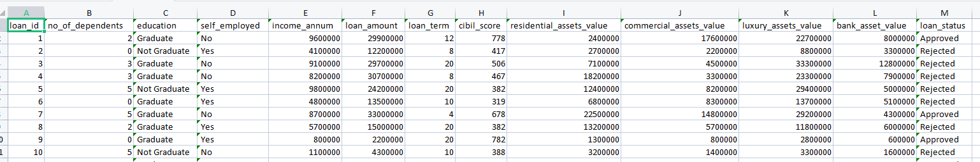
Data Understanding:
Source: The dataset used is from Kaggle.
Volume: The dataset contains 4269 records, offering sufficient data points to train, validate, and test
Variety: The dataset consists of 13 distinct features, encompassing both numerical variables (e.g., income, loan amount) and categorical variables (e.g., gender, education, marital status)
Velocity: Static data (not real-time).
Veracity: Kaggle is considered a trusted source.
Value: The dataset is suitable for predicting loan eligibility of applicants.
A snippet of the dataset
https://www.kaggle.com/datasets/architsharma01/loan-approval-prediction-dataset

Slide 8
Data Preparation:
Cleaning Data: Removed leading and trailing spaces from column names
Encoding Categorical Features: Applied Label Encoding to convert categorical variables into numerical representations.
Data Partitioning: Split the dataset into training, validation, and test sets to evaluate model performance

Slide 9
Modelling Pipeline :
Now lets go through the workflow, showing the sequential stages and tools used for data processing, model building, and deployment.
1. Data Source
- Kaggle and CSV files: The data originates from external sources like Kaggle datasets or locally stored CSV files.
2. Data Storage
- GitHub: Acts as the repository to store, version, and manage the code and data, providing a centralized storage.
3. Extract & Load
-Jupyter Notebook and VS Code: These tools are used for loading and managing the data. They serve as Integrated Development Environments (IDEs) where the code for data extraction, loading, and processing is written and executed.
4. Data Preprocessing
-Python with libraries like NumPy and Pandas: This stage involves cleaning, transforming, and preparing the data for analysis.

Slide 10
5. Data Visualization
- Matplotlib, Plotly: These libraries create visualizations to understand data patterns, trends.
6. Model Building
- Scikit-Learn: This machine learning library provides algorithms for model training, testing, and evaluation. Scikit-Learn is used to build predictive models based on the preprocessed data.
7. Process Streamline
- Apache Airflow: This workflow management tool automates the entire pipeline, ensuring that each step is executed in sequence.
8. Deployment
- AWS (Amazon Web Services): Once the model is trained, it’s deployed on AWS for scalability and accessibility. This deployment allows the model to be used in real-time applications.

Slide 11
Modeling:
These models were built on the dataset: Logistic Regression, Decision Tree Classifier, KNN Classifier, Random Forest Classifier, XGBoost Classifier.
Evaluation:
These Models are evaluated with the help of performance metrics (Accuracy, Precision,F1-Score, etc)

Slide 12






Results: Model Performance Metrics:

Slide 13
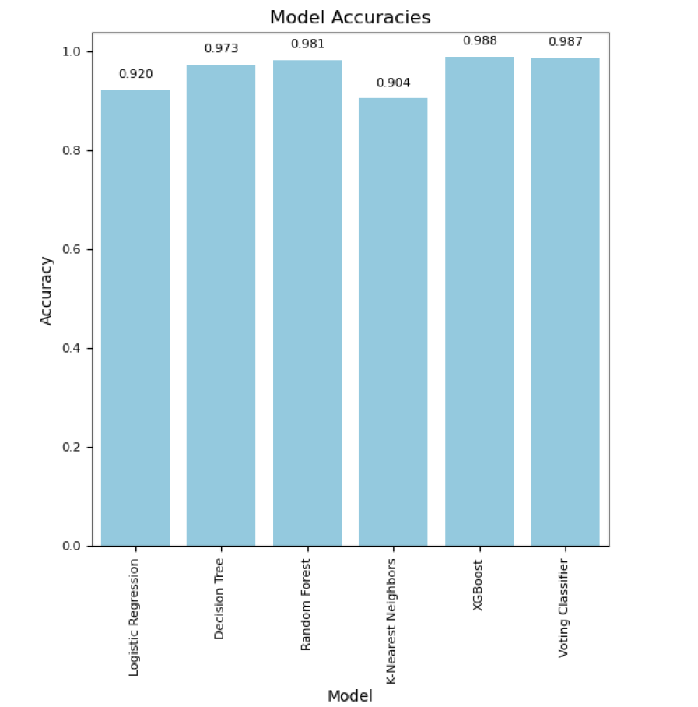
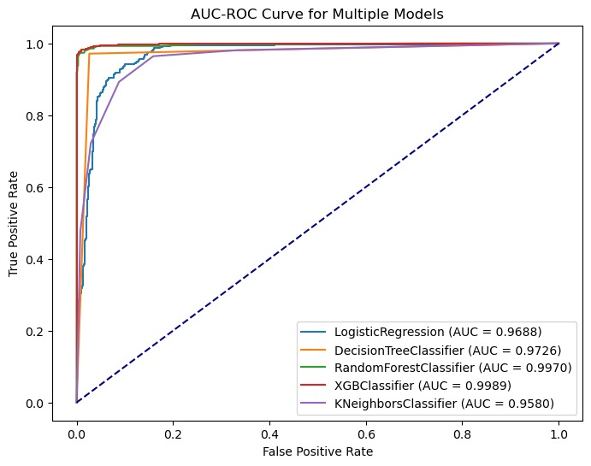
Results:

Slide 14
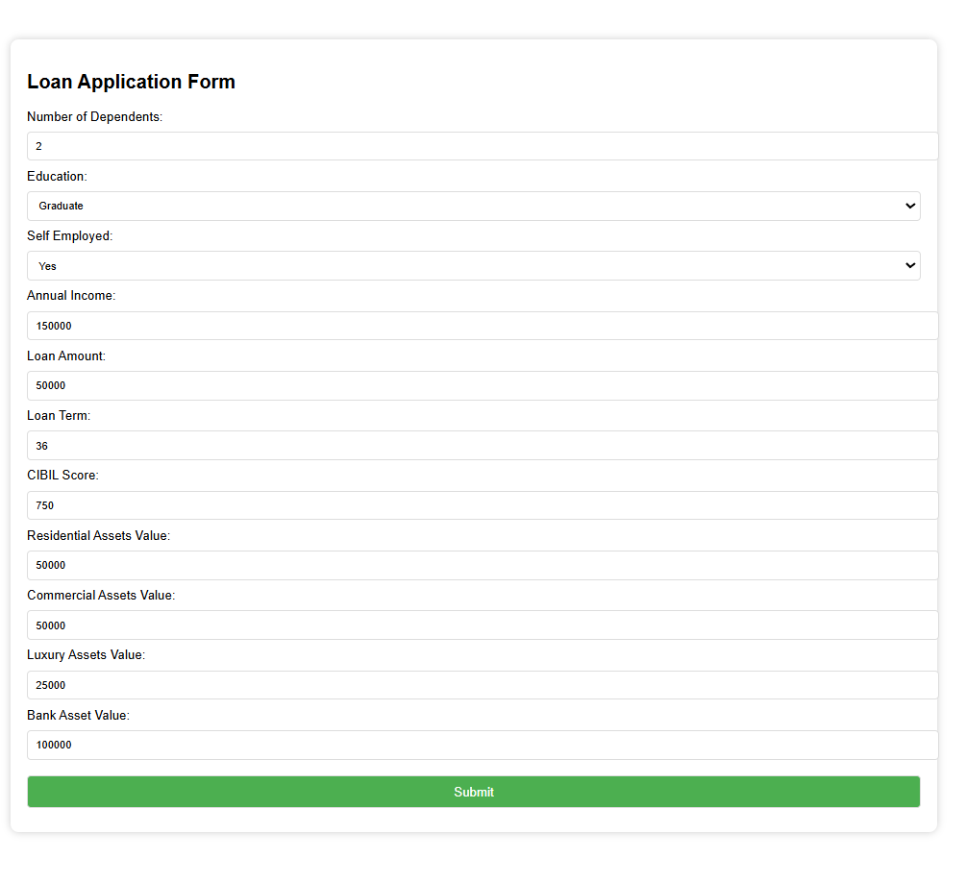
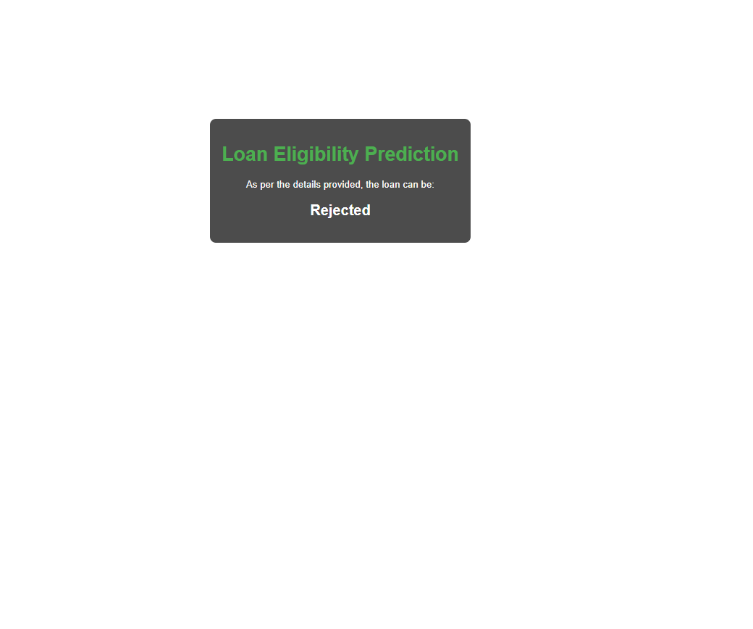
Results: Deployment on AWS

Slide 15


Slide 16
Conclusion:
By implementing this application, clients can reduce default rates, improve operational efficiency, and enhance customer trust by offering faster and more accurate loan eligibility decisions.

Slide 17
Any Queries???
Thank you!

